Slide 1
Discrete Mathematics
Dr. Han Huang
South China University of Technology

Slide 2
Chapter 8. Graphs
Euler and Hamilton Paths
Section 6.5

Slide 3
Contents
1
Euler Paths and Circuit
2
Hamilton Paths and Circuit

Slide 4
Euler Paths and Circuit

Slide 5
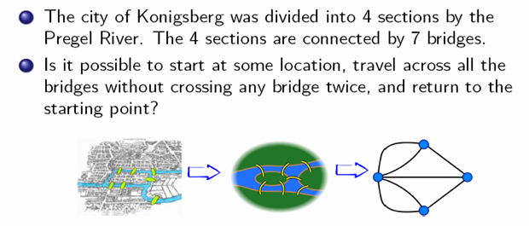
Konigsberg Seven Bridges Problem

Slide 6
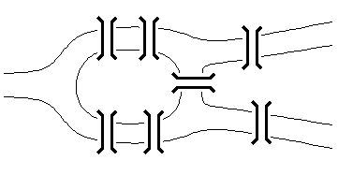
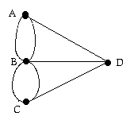
Konigsberg Seven Bridges Problem
The original problem
Equivalent multigraph
The Swiss mathematician Leonhard Euler solved this problem. His solution, published in 1736, may be the first use of graph theory.
Euler studied the problem by using a multiple graph.

Slide 7
Euler circuit
Definition 1:
An Euler circuit in a graph G is simple circuit containing every edge of G.
An Euler path in G is a simple path containing every edge of G.
No solution!!

Slide 8
Example 1
a
b
e
d
c
G1
The graph G1 has an Euler circuit, for example a, e, c, d, e, b, a.

Slide 9
Example 1
a
b
e
d
c
G2
G2 does not have an Euler circuit.
G2 does not have an Euler path, either.

Slide 10
Example 1
a
b
d
c
e
G3
G3 does not have an Euler circuit.
G3 has an Euler path: a, c, d, e, b, d, a, b.

Slide 11
Necessary and Sufficient Conditions
There are simple criteria for determining whether a multigraph has an Euler circuit and Euler path.
An Euler circuit begins with a vertex a and continues with an edge incident to a, say {a,b}.
The edge {a, b} contributes one to deg(a).
Each time the circuit passes through a vertex it contributes two to the vertex’s degree, since the circuit enters via an edge incident with this vertex and leaves via another such edge.

Slide 12
Necessary and Sufficient Conditions
Therefore, deg(a) must be even, because the circuit contributes two every time when it passes through a.
We conclude that if a connected graph has an Euler circuit, then every vertex must have even degree.
Therefore, if a connected graph has an Euler circuit, then every vertex must have even degree.
Necessary condition!!!

Slide 13
Necessary and Sufficient Conditions
Is this necessary condition for the existence of an Euler circuit also sufficient?
An Euler circuit exists in a connected multigraph if all vertices have even degree?
The proof is given with a construction.
Suppose that the degree of every vertex of G is even.
We can build a simple path {x0,x1},{x1,x2},…,{xn-1,xn} where x0=a is an arbitrary vertex.

Slide 14
b
a
d
f
c
e
It begins at a with an edge of the form {a, x}, and it terminates at a with an edge of the form {y, a}.
Each time the path goes through a vertex with even degree, it uses only one edge to enter this vertex,
So that at least one edge remains for the path to leave the vertex.

Slide 15
An Euler circuit has been constructed if all the edges have been used.
Otherwise, consider the subgraph H obtained from G by deleting the edges already used and vertices that are not incident with any edges.
When we delete the circuit a, f, c, b, a from the graph in Figure 5, we obtain the subgraph labeled as H.

Slide 16
b
d
a
c
d
e
f
G
c
H
e
Since G is connected, H has at least one vertex in common with the circuit that has been deleted. Let w be such a vertex.

Slide 17
Every vertex in H has even degree.
H may not be connected.
Beginning at w, construct a simple path in H by choosing edges as long as possible, as was done in G.
This path must terminate at w.
For instance, c, d, e, c is a path in H. Form a circuit in G by splicing the circuit in H with the original circuit in G.

Slide 18
b
d
a
c
d
e
f
c
G
H
e
Form a circuit in G by splicing the circuit in H with the original circuit in G. This can be done since w is one of the vertices in this circuit.
When this is done in the graph in Figure 5, we obtain the circuit a, f, c, d, e, c, b, a.

Slide 19
Continue this process until all edges have been used.
The process must terminate since there are only a finite number of edges in the graph.
This produces an Euler circuit .
If the vertices of a connected multigraph all have even degree, then the graph has an Euler circuit.

Slide 20
Theorem 1: A connected multigraph has an Euler circuit if and only if each of its vertices has even degree.
4 vertices of odd degree, it does not have an Euler circuit.

Slide 21
Example 2
a
b
d
c
H1
H1 does not have an Euler circuit.
H1 does not have an Euler path, either.

Slide 22
Example 2
b
a
g
f
c
e
d
H2
H2 has an Euler circuit:
a, g, c, b, g, e, d, f, a

Slide 23
Example 2
c
d
a
b
H3
H3 does not have an Euler circuit.
H3 has an Euler path: c, a, b, c, d, b

Slide 24
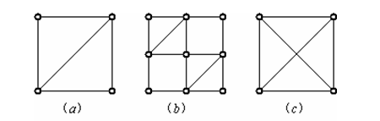
More examples
(a) and (c) does not have an Euler circuit.
(a) and (c) does not have an Euler path, either.
(b) has both an Euler circuit and an Euler path.

Slide 25
Algorithm
Algorithm 1 gives the constructive procedure for finding Euler circuits given in the discussion preceding Theorem 1.
The algorithm specifies the steps of the procedure more precisely.

Slide 26
Algorithm 1 Constructing Euler Circuit
Procedure Euler (G: connected mutilgraph with all vertices of even degree)
1: circuit := a circuit in G beginning at an arbitrarily chosen vertex with edges successively added to form a path that returns to this vertex.
2: H := G with the edges of this circuit removed

Slide 27
Algorithm 1 Constructing Euler Circuit
3: while H has edges
Begin
subcircuit := a circuit in H beginning at a
vertex in H that also is the endpoint of an edge
of circuit
H := H with edges of subcircuit and all isolated
vertices removed
circuit := circuit with subcircuit inserted at the
appropriate vertex
End {the circuit is an Euler circuit.}

Slide 28
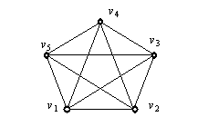
Example
C1 in G：v1 v2 v3 v4 v5 v1
C2 in G－C1 : v1 v3 v5 v2 v4 v1
v1 is the shared vertex of C1 and C2.
The Euler circuit is : v1 v2 v3 v4 v5 v1 v3 v5 v2 v4 v1

Slide 29
Example 3
Mohammed s scimitars
Every vertex has even degree.
Therefore, we can use algorithm 1 to solve its Euler circuit.
a
e
i
j
f
b
g
d
g
k
c
G

Slide 30
Example 3
a
e
i
j
f
G
H
b
h
d
g
k
c
1、a, b, d, c, b, e, i, f, e, a in G
2、d, g, h, j, i, h, k, g, f, d in H
3、 a, b, d, g, h, j, i, h, k, g, f, d, c, b, e, i, f, e, a

Slide 31
Theorem 2: A connected multigraph has an Euler path but not an Euler circuit if and if only if it has exactly two vertices of odd degree.
Main idea of the proof :
Every time the path goes through a there is path contributes one to the degree of a.
The terminal and the beginning vertices have odd degree.

Slide 32
Example 4
a
b
d
c
G1
G1 contains exactly two vertices of odd degree, namely, b and d.
Euler path: d, a, b, c, d, b

Slide 33
Example 4
g
f
a
e
b
G2
c
d
G2 contains exactly two vertices of odd degree, namely, b and d.
Euler path: b, a, g, f, e, d, c, g, b, c, f, d

Slide 34
a
b
e
d
c
G3
G3 has no Euler path since it six vertices of odd degree.

Slide 35
4 vertices of odd degree, it does not have an Euler path, such trip is impossible.

Slide 36
Application of Euler path
Chinese postman problem
If a postman can find an Euler path in the graph that represents the streets the postman needs to cover, this path produces a route that traverses each street of the route exactly one.
If no Euler path exists, some streets will have to be traversed more than once.

Slide 37
Hamilton Paths and Circuit

Slide 38
( Hamilton Paths
An Euler circuit in a graph G is a simple circuit containing every edge of G.
An Euler path in G is a simple path containing every edge of G.
A Hamilton circuit is a circuit that traverses each vertex in G exactly once.
A Hamilton path is a path that traverses each vertex in G exactly once. )

Slide 39
Hamilton Paths
Definition 2:
A path x0, x1, …, xn-1, xn in the graph G = <V, E> is called a Hamilton path if V = {x0, x1,…, xn-1, xn} and xi≠xj for 0≤i<j≤n.
A circuit x0, x1, …, xn-1, xn is a Hamilton path.

Slide 40
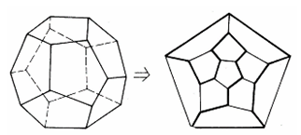
Source of the terminology
Hamilton path comes from a game, called Voyage Round the word puzzle, invented by Irish mathematician Sir William Rowan Hamilton.
The puzzle was to start at a city and travel along the edges of the dodecahedron, visiting each of the other 19 cities exactly once, and back for the first city.

Slide 41
Example 5
a
b
e
c
G1
d
G1 has a Hamilton circuit: a, b, c, d, e, a.

Slide 42
Example 5
a
b
d
c
G2
G2 does not have a Hamilton circuit.
G2 has a Hamilton path: a, b, c, d.

Slide 43
Example 5
b
g
a
d
c
e
f
G3
G3 does not have a Hamilton circuit.
G3 does not have a Hamilton path.

Slide 44
Surprisingly, there are no known simple necessary and sufficient criteria for the existence of Hamilton circuits.
However, some sufficient criteria are know.
1、a graph with a vertex of degree one cannot have a Hamilton circuit.
2、a Hamilton circuit cannot contain a smaller circuit within it.

Slide 45
Example 6
a
d
e
b
c
G
There is no Hamilton circuit in G
since G has a vertex of degree one.

Slide 46
Example 6
a
b
c
d
e
H
All vertices have two degree.
But H has no Hamilton circuit, for any possible Hamilton circuit have to pass c twice.

Slide 47
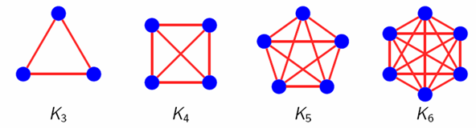
Example 7
We can form a Hamilton circuit in Kn beginning at any vertex.
Such a circuit can be built by visiting vertices in any order we choose, which is possible since there are edges in Kn between any two vertices.

Slide 48
Hamiltonian Path Theorems
Dirac’s theorem: If (but not only if) G is connected, simple, has n≥3 vertices, and ∀v deg(v)≥n/2, then G has a Hamilton circuit.
Ore’s theorem : If G is connected, simple, has n≥3 nodes, and deg(u)+deg(v)≥n for every pair u,v of non-adjacent nodes, then G has a Hamilton circuit.

Slide 49
Proof in Chinese
Ore’s theorem： G＝<V，E>是n阶简单图，n≥3，则：
(1)如任两不相邻结点u、v∈V，均有d(u)＋d(v)≥n－1，则在G中存在一条哈密尔顿路。
(2)如任两不相邻结点u、v∈V，均有d(u)＋d(v)≥n，则G是哈密尔顿图。
证明 (1)先证G是连通的。若G不连通，设G₁、G₂为其两个连通分支，u、v分别是G₁、G₂的结点，则u、v在G中不相邻且有d(u)＋d(v)≤|V(G₁)|－1＋|V(G₂)|－1≤n－2，与已知矛盾，所以G是连通的。

Slide 50
再证G中存在一条哈密尔顿路。设Γ：v₁v₂…v_{s}是G的最长的基本路，则s≤n。若s＜n，先证G中必有经过v₁、v₂、…、v_{s}的回路。
若v₁与vs邻接，则Γ与边[v₁，v_{s}]构成一个回路。若v₁与v_{s}不邻接，因为Γ：v₁v₂…v_{s}是G的最长的基本路，所以v₁与v_{s}的邻接结点都在Γ上。

Slide 51
设v₁的邻接结点依Γ上的顺序为 ，(2≤i₁≤…≤i_{k}≤s－1)，若v_{s}与 中的结点都不邻接，则d(v_{s})≤s－k－1，于是d(v₁)＋d(v_{s})≤k＋s－k－1＜n－1，矛盾。
所以，存在j∈{1，2，…，k}，使v_{s}与邻接，这时
构成一个回路。

Slide 52
由G是连通的，而s＜n，所以存在G的不在Γ上的结点v，v至少与Γ上的某个结点邻接。不妨设v与v_{r}邻接，若r＜i_{j}－1，则 构成长度为s的基本路；若 ，则
构成长度为s的基本路，与Γ的选取矛盾。
所以s＝n。Γ：v₁v₂…v_{s}就是G的一条哈密尔顿路.

Slide 53
(2)如任两不相邻结点u、v∈V，均有d(u)＋d(v)≥n，则G是哈密尔顿图。
(2)证明：设Γ：v1v2…vn是G中的哈密尔顿路，若v1与vn邻接，则Γ∪{[v1，vn]}是一条哈密尔顿回路；若v1与vn不邻接，类似(1)可证有一条通过Γ的所有结点的一条回路，该回路即为哈密尔顿回路。

Slide 54
Both Ore’s Theorem and Diac’s Theorem provide sufficient conditions for a connected simple graph to have a Hamilton circuit.
However, the theorems do not provide necessary conditions for the existence of a Hamilton circuit.

Slide 55
The best algorithm known for finding a Hamilton circuit in a graph or determining that no such circuit exist have exponential worst-case time complexity.
Finding an algorithm that solves this problem with polynomial worst-case time complexity would be a major accomplishment because it has been proved to be NP-complete.

Slide 56
Application
Hamilton circuits and paths can be used to solve practical problems.
Traveling salesman problem asks for the shortest route a traveling salesman should take to visit a set of cities.
The problem reduces to finding a Hamilton circuit in a complete graph such that the total weight of its edges is as small as possible.

Slide 57
Applications

Slide 58
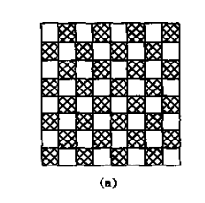
Applications
1.在8*8黑白相同的棋盘上跳动一只马，不论跳动方向如何，要使这只马完成每一种可能的跳动恰好一次（即不产生重复的跳动），请问有可能吗？

Slide 59
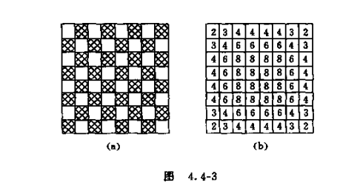
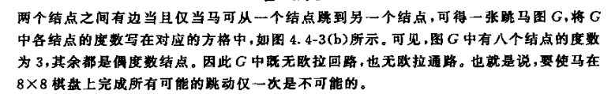
Applications
（x,y）
(x+2,y+1)
(x+2,y-1)
(x-2,y+1)
(x-2,y-1)
(x+1,y+2)
(x+1,y-2)
(x-1,y+2)
(x-1,y-2)

Slide 60

2. 11个学生打算这几天都在一张圆桌上共进午餐，并且希望每次午餐时每个学生两旁所坐的人都不同，问这11个人共进午餐最多能有多少天？（提示无向完全图K_{n}有 条无公共边的汉密尔顿回路）

Slide 61
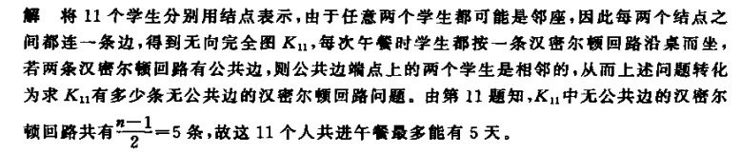
2. 11个学生打算这几天都在一张圆桌上共进午餐，并且希望每次午餐时每个学生两旁所坐的人都不同，问这11个人共进午餐最多能有多少天？（提示无向完全图K_{n}有 条无公共边的汉密尔顿回路）

Slide 62
End of Section 6.5
Click to edit company slogan .

